Slide 1
ENGLISH CAMP Verona 2024
Join us for 2 weeks of English speaking, action packet sports, performing arts and physical activities!
www.clubszone.co.uk/verona

Slide 2
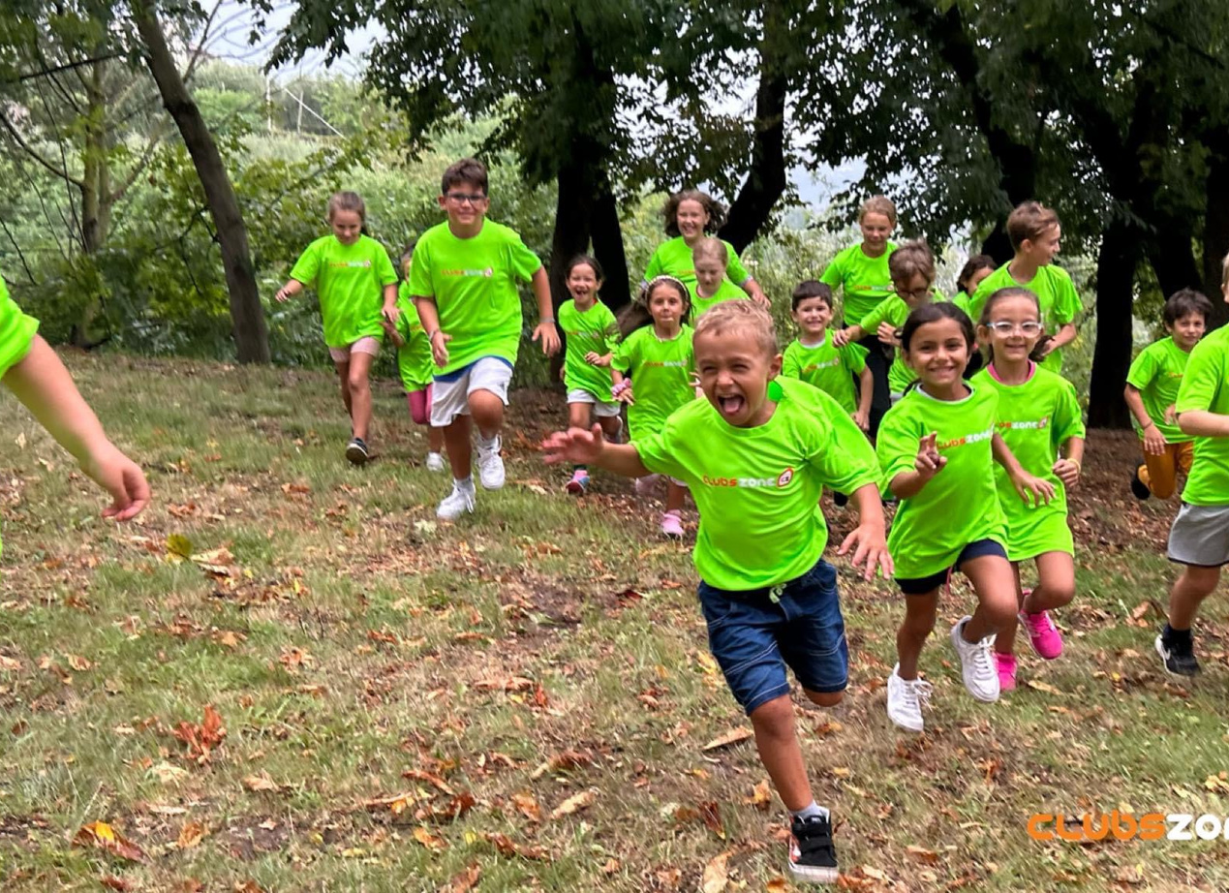
Who are Clubszone?
Clubszone is an established children’s activity provider within the Midlands, England with over 15 years of experience. Our holiday clubs cover a variety of fun and engaging activities including sports, performing arts and arts and crafts. We offer fantastic value for money and treat customer service as the top priority when it comes to delivering our provision for both our parents and children.
Our camps are fully inclusive to all children of any ability and backgrounds. The camp is designed to have fun and enjoy new activities that they wouldn’t normally have the opportunity to take part in.
www.clubszone.co.uk/verona

Slide 3
Verona 2023
Last year was our first holiday camp in the beautiful Verona! We had an amazing 2 weeks of fun in the sun with over 20 children. Two different cultures were shared between the staff and the kids with many parents giving feedback that their childs English had improved in both speaking and listening.
The children participated in a wide variety of activities and games, many of which they had never heard of or taken part in. All activites were presented and explained in English by our coaches to help assist the learning of the English language. Next year we would like to give more children this oppurtunity to learn, grow and develop in a fun and engaging environment.
We hope that the children’s experiences have made memories that will last a lifetime!
www.clubszone.co.uk/verona

Slide 4
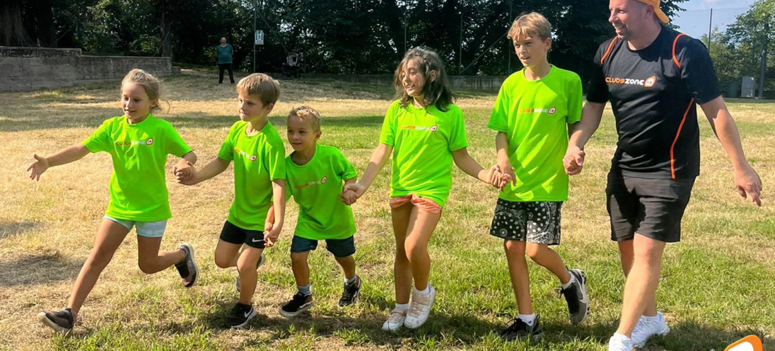
A Day at Clubszone
Example Daily Timetable
Each day will be as different as possible to ensure that all of the children benefit from every activity. Our timetable will be ammended to suit each child giving them the opportunity to help plan the following day.
www.clubszone.co.uk/verona

Slide 5
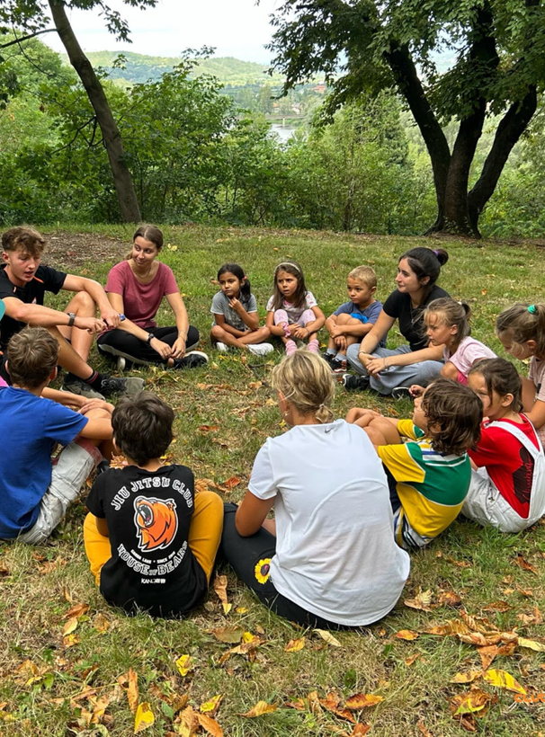
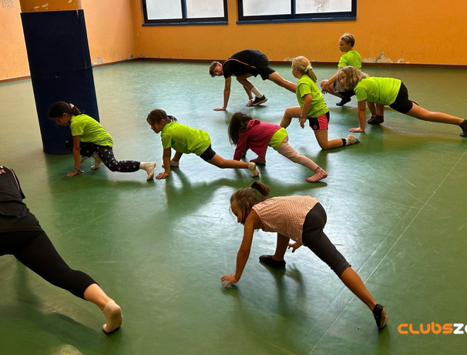
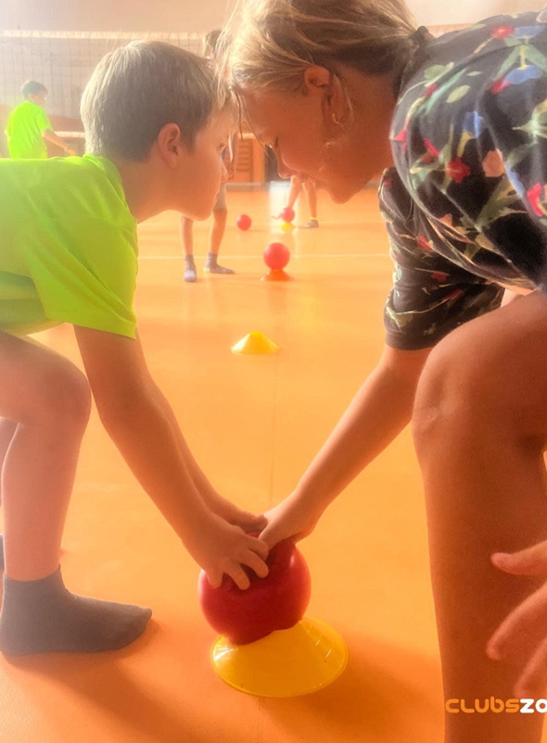
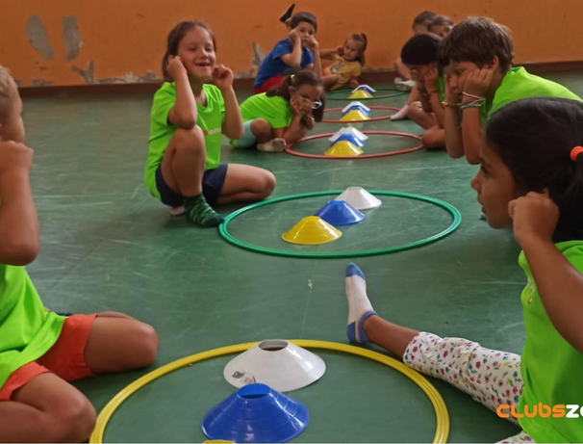
Activities we offer
•Gymanstics•Dodgeball•Badminton•Netball•Athletics•Archery •Fencing•Drama•Quad Ball •Volleyball•Table Tennis•Laser Tag•Water Games•Obstacle Course•Pac-man•Hide and Seek•Handball
•Football•Dance•Tennis•Arts and Crafts•Rounders •Basketball•Cricket•Uni-Hock•Tag Rugby•Multi Sports•Team Games •Pickleball•Parachute•Yoga and Many More!
www.clubszone.co.uk/verona

Slide 6
Why Clubszone is the place to be!
Experience
Quality
Variety
Cost-effective
www.clubszone.co.uk/verona

Slide 7
Testimonials
Parent
Fist time with Clubszone and positive experience
First time we tried Clubszone and my 10 year old kids enjoy a lot, especially different sports they didn't know before. The staff were funny and caring with them. Speaking english was a plus in Verona. In general they had a great time!!
Child
I like playing new games and with the staff, they are very friendly.
I want to come again next summer! thank you!
www.clubszone.co.uk/verona

Slide 8
Meet the team
Marc
Katie
Alvaro
Owen
Adam
www.clubszone.co.uk/verona

Slide 9
Verona 2024 Details
Citella, Via Citella, 48, 37012, Bussolengo, Verona, Italy
10/6/2024 - 14/6/2024
17/6/2024 - 21/6/2024
8:00am - 4:00pm
For children aged 5 to 13 years old
www.clubszone.co.uk/verona

Slide 10
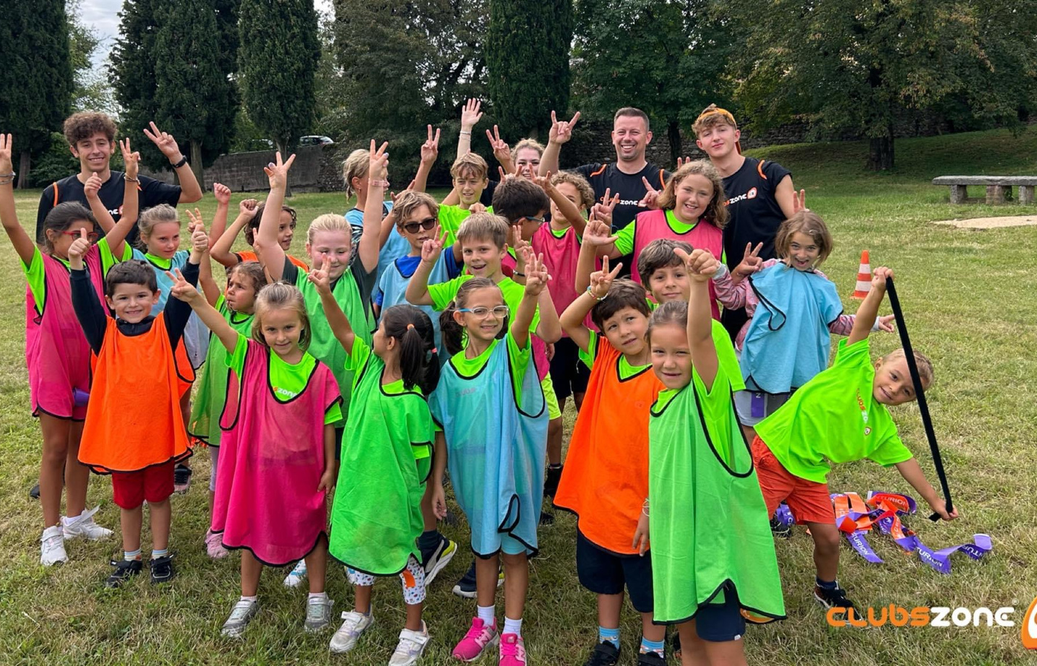
Contact Us
+44 116 279 5099
Bookings@clubszone.co.uk
www.clubszone.co.uk/verona

